Slide 1


SILK SONG
2023
张天磊 (Zhang Tianlei) 哈尔滨工程大学
吴俊彤 (Wu Juntong) 华中农业大学
余晨炜 (YuChenwei) 华中科技大学
杨智程 (Yang Zhicheng) 北京邮电大学

Slide 2

行业PPT模板http://www.1ppt.com/hangye/
1
Game Overview
2
Idea & cool things
CONTENT
3
Fun?Fun!
4
Technic difficulty

Slide 3
1
Game Overview

Slide 4
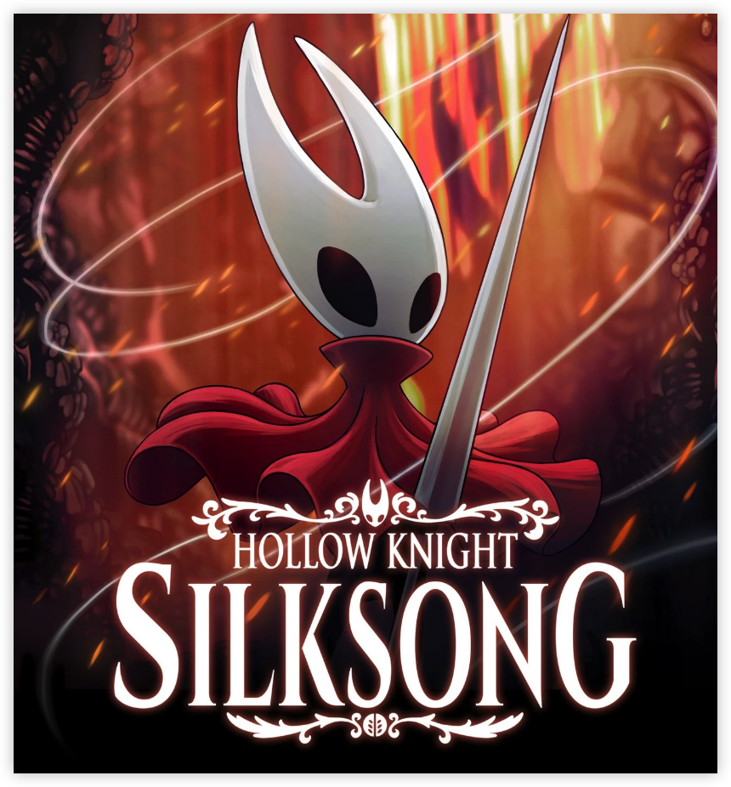
Game name: Silk Song
Brief Introduction
Play as young Hornet in the underground world, defeat enemies along the way, become a strong fighter in Hollow Nest.
Target of the Game
Kill the final Boss and get out from the underworld.
Lose game when you die, but you will respawn in the last chair. :)
Plot
The story before Hollow Knight.
Hornet have fallen into a dangerous place.
(It's a poster from team cherry)

Slide 5







Game Control
L: Dash
U: Heal
J: Attack
A/D: Move
W+J: Upward attack
S+J (in air):
Downward thrust
K: Jump

Slide 6
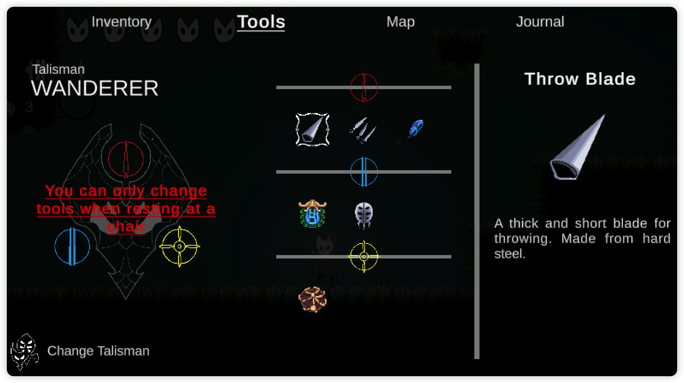
Early UI Design

Slide 7
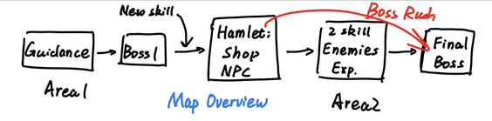
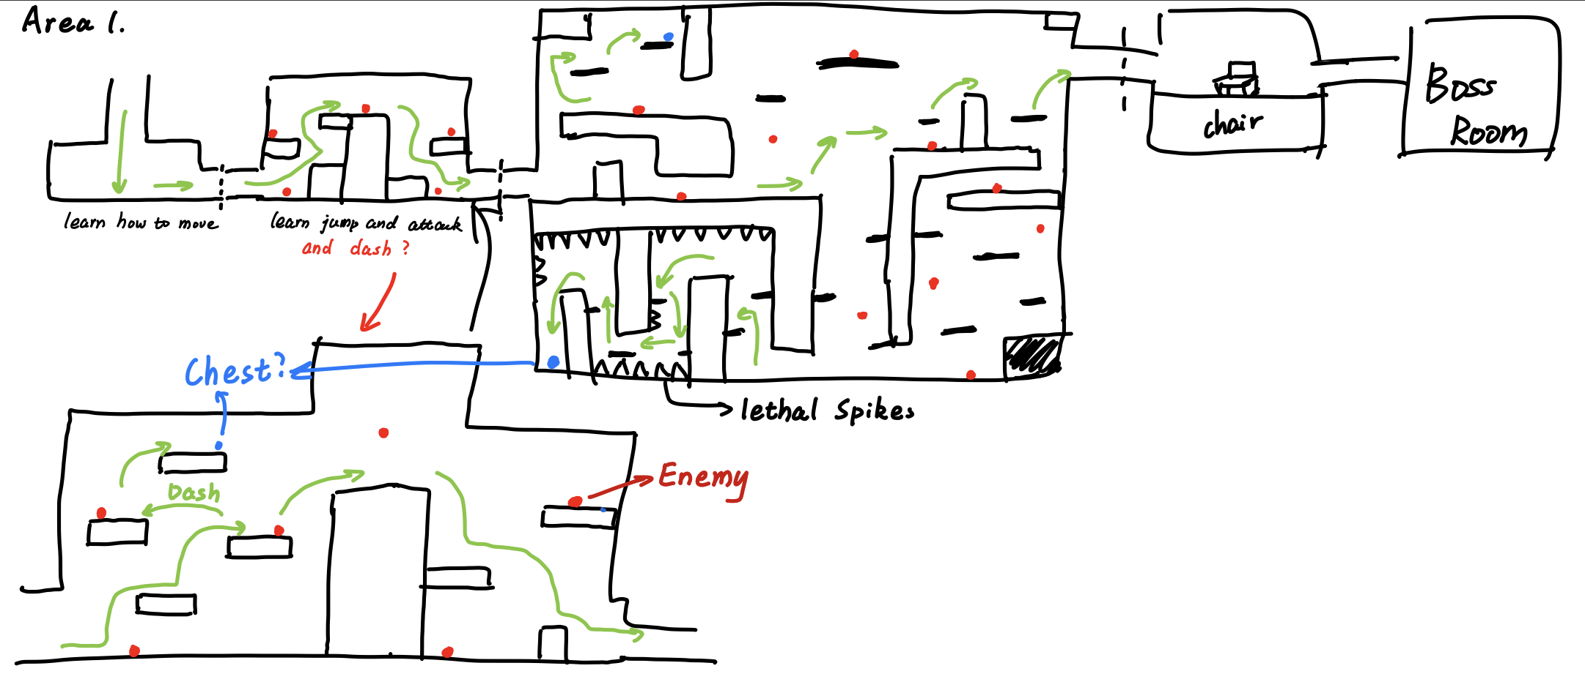
Other Sketches:
Map Overview:

Slide 8
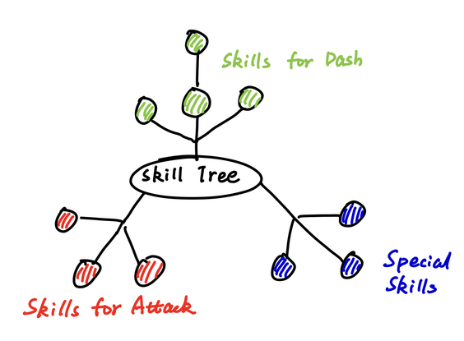
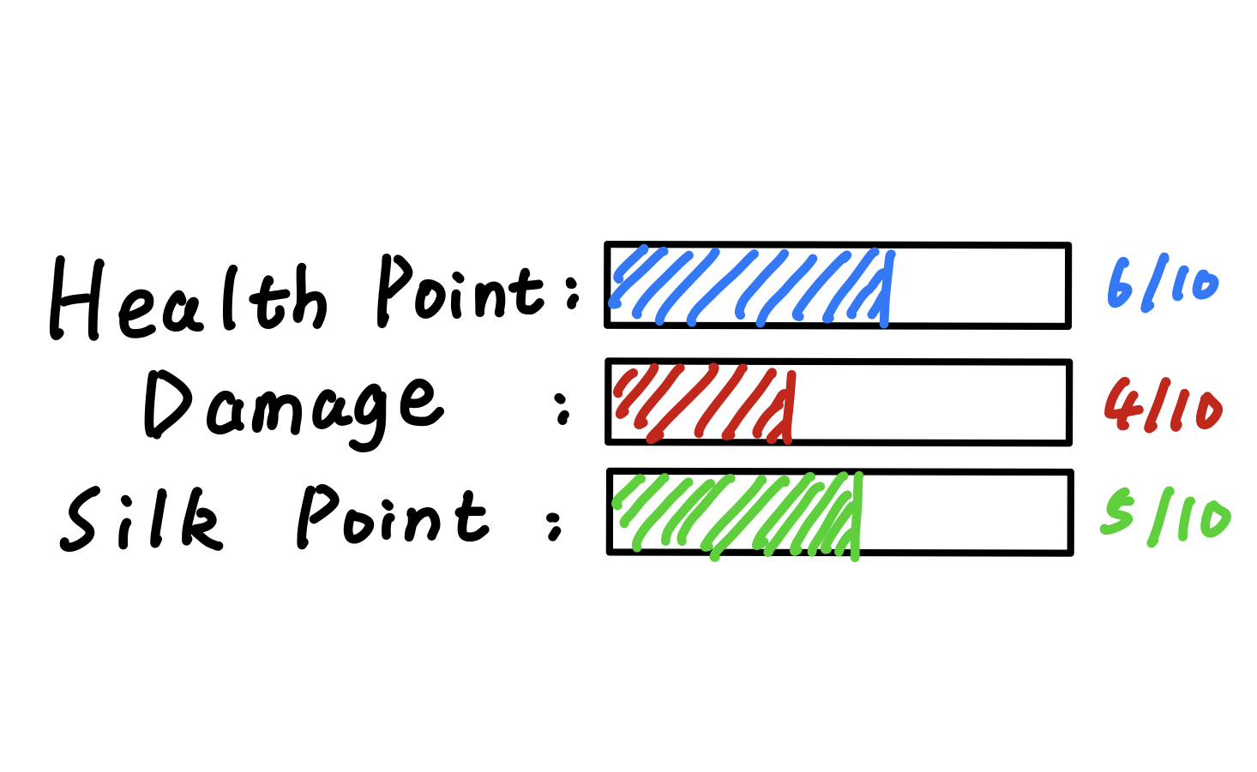
Achievements and Upgrades
Skill Tree
Build System
When you level up,
you can make yourself stronger.
Use loot to learn new skills!

Slide 9
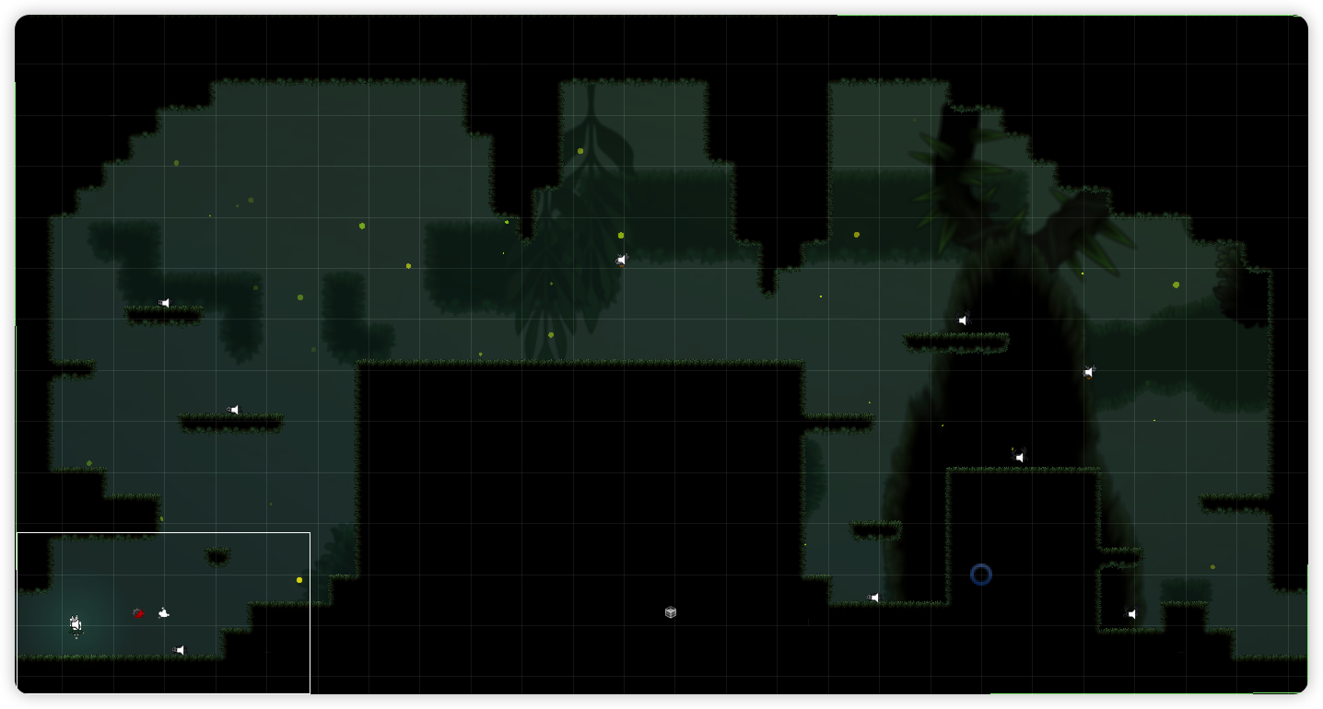
We have completed some of them!

Slide 10
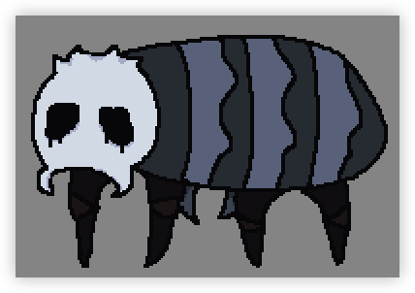
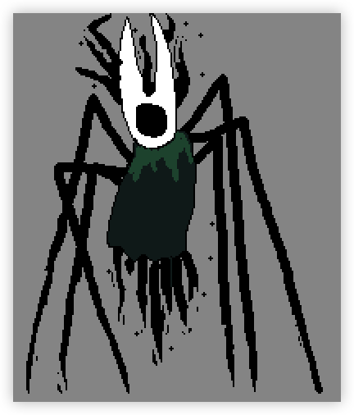




Some Enemies:
More enemies in the upcoming version!

Slide 11
2
Innovative Idea

Slide 12

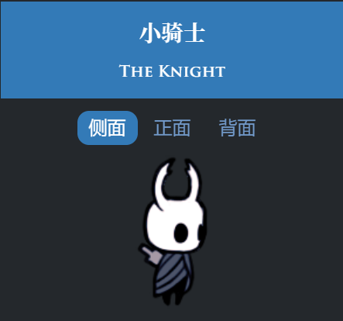
Our Story
His Story
- Before ->
Hornet (大黄蜂)
aka
"The young sister" (小姐姐)
The Knight
He is NOT in our Game

Slide 13
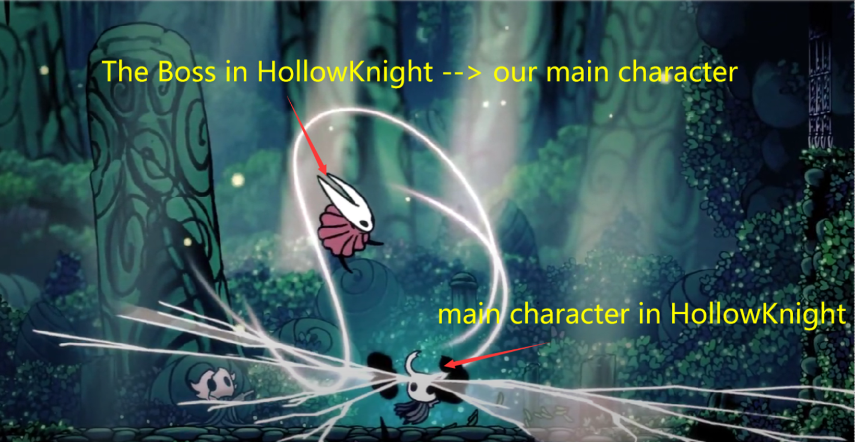
A role playing Game
Train a Boss ? Yes !

Slide 14

As a Boss , she needs to be :
(SSS)
Strong
Skillful
Smart
Players act as

Slide 15
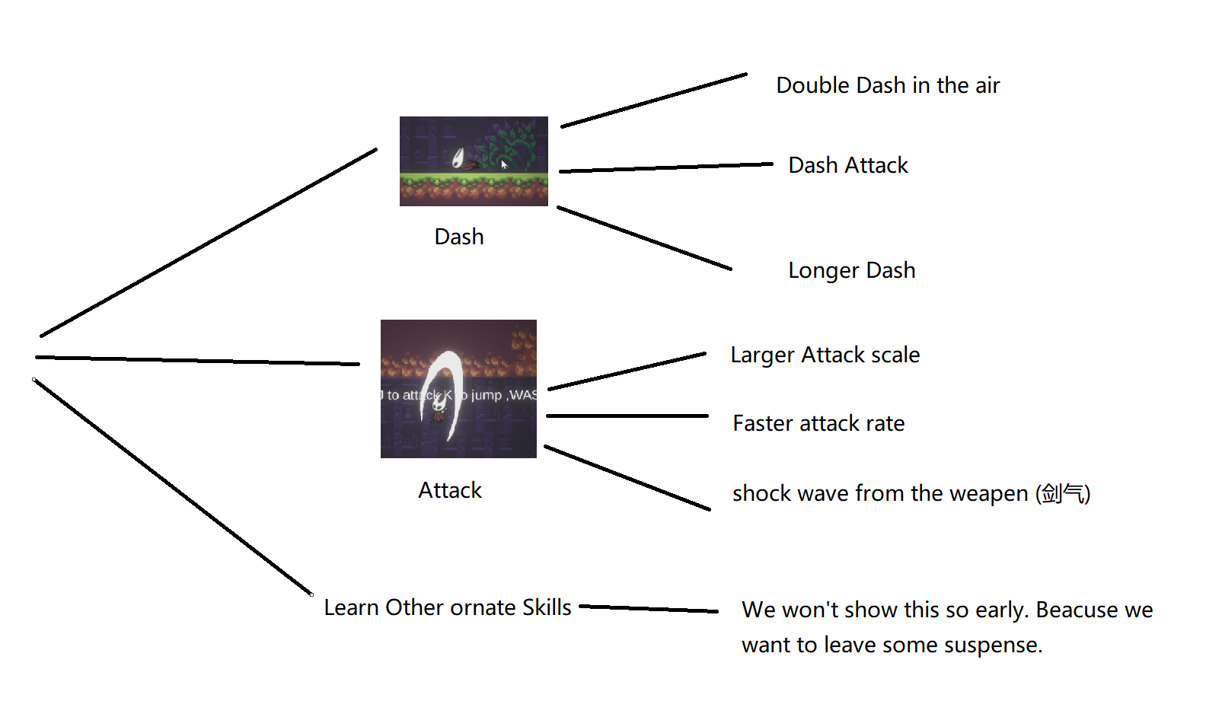
Have enough money ?
Lighten up your skill tree!
v
v
v
v
v
v

Slide 16
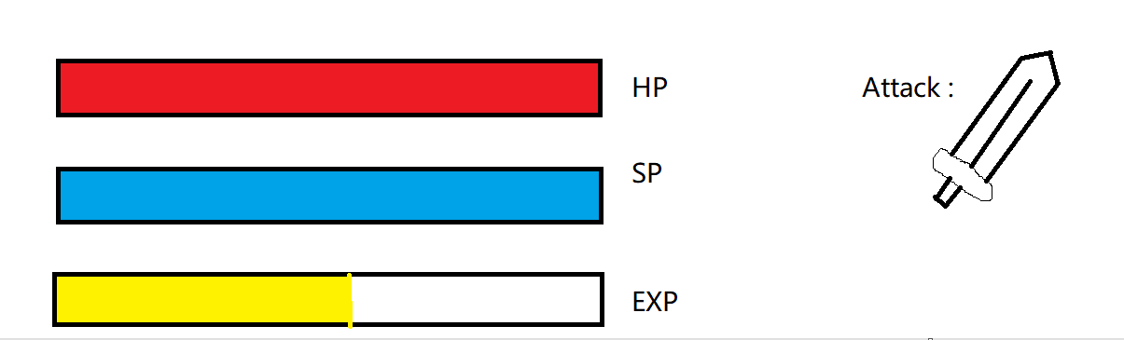
Level up ?
Making decisions !

Slide 17

Get Ready ?
Go for your first challenge !

Slide 18
3
For What?Only Fun!

Slide 19

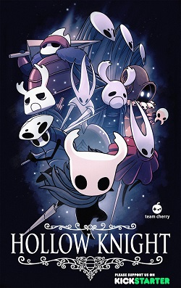
What's this ？
You may say：Hey, I Know <<Hollow Knight>>

Slide 20

Yeah, you are Right !
These are what Hollow Knight have!
I mean tons of things!
A chair you can sit !
open world！（Mistaken）
?
You can:
Heal!
Equip!

Slide 21

Strong BOSS battle
Be Careful with your each MOVE！
You can：
Challenge！ Enjoy！ Replay！

Slide 22
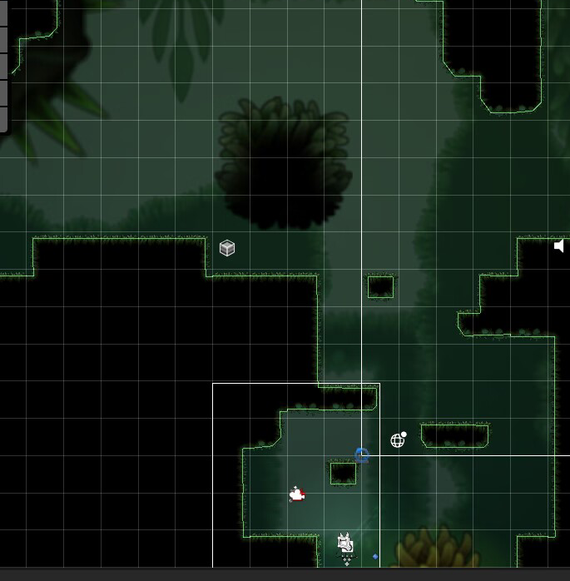
Amazing map designing！
Collect!
Jump!

Slide 23
Enjoy Classic Metroidvania game？
银河恶魔城
You can finish the game with you only weapon and your skills to improve your masterpieces!
From the Beginning to the End!

Slide 24
But I would say: that's Not enough!

Slide 25


What is our game?
√
X

Slide 26

Play With RPG
Boss too strong ? And you are so Vegetable?
try to level up!
LV 999 !!!
Who is the Boss now!
Life：999
Atk ：100000000
You:
LV 10

Slide 27
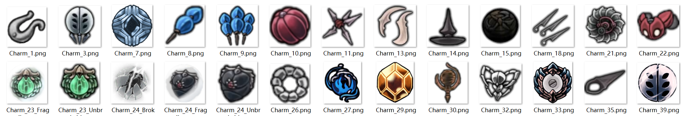


Play With RPG
Attack too simple？
try to level up!
Mutiple Skills and new Abilities can be bought by the SP
Explore
Battle
战斗
X times Jump?
Double times dash？
Not enough！
Powerful attack mode?
探索
New weapons？
Do it！

Slide 28
Be the master of your own ship！
Challenging yourself
or
Grind for EXP
That‘s UP to YOU！

Slide 29
4
Technic difficulty
The complex battle system and the character building system both offer some

Slide 30
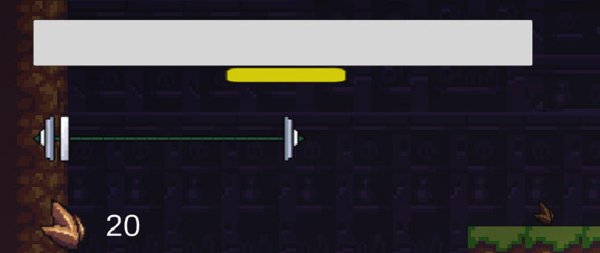
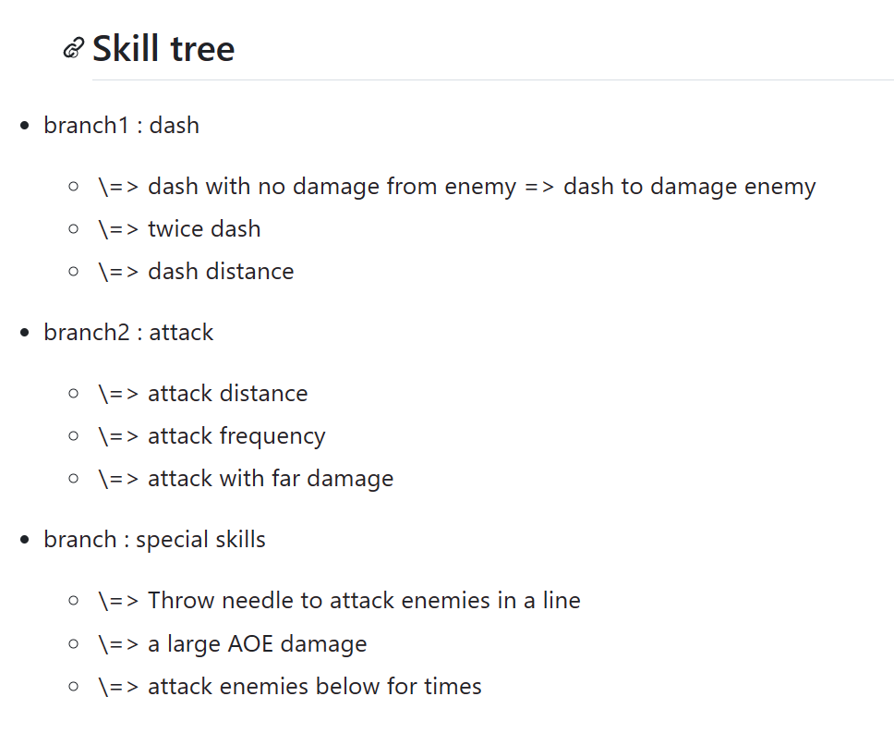
The skills and ability
The HP, Exp, Silk and the money
The skills tree
Players need to choose which skill they like and to improve their abilities.
So ,for us, it is difficult to make a reasonable and attractive system

Slide 31
More complex battle system
Many skills
Player can use many skills when they fight, we need to make sure they are
correct to use
Some features
You can use skills and attack when you are dashing, so we need to merge them right and fun.
Many interactive
You can against the boss when you fight with it, and we tend to ensure the experience.
Others
We have some explorable scene need to finish if we have enough time. And the AI of enemies need to be refined.

Slide 32
How about it?
We think the most complex point in our game is the build-up system of our main role and the fight with enemies, we need to take a lot of time to finish them and they are also our core interest to attract our gamer

Slide 33
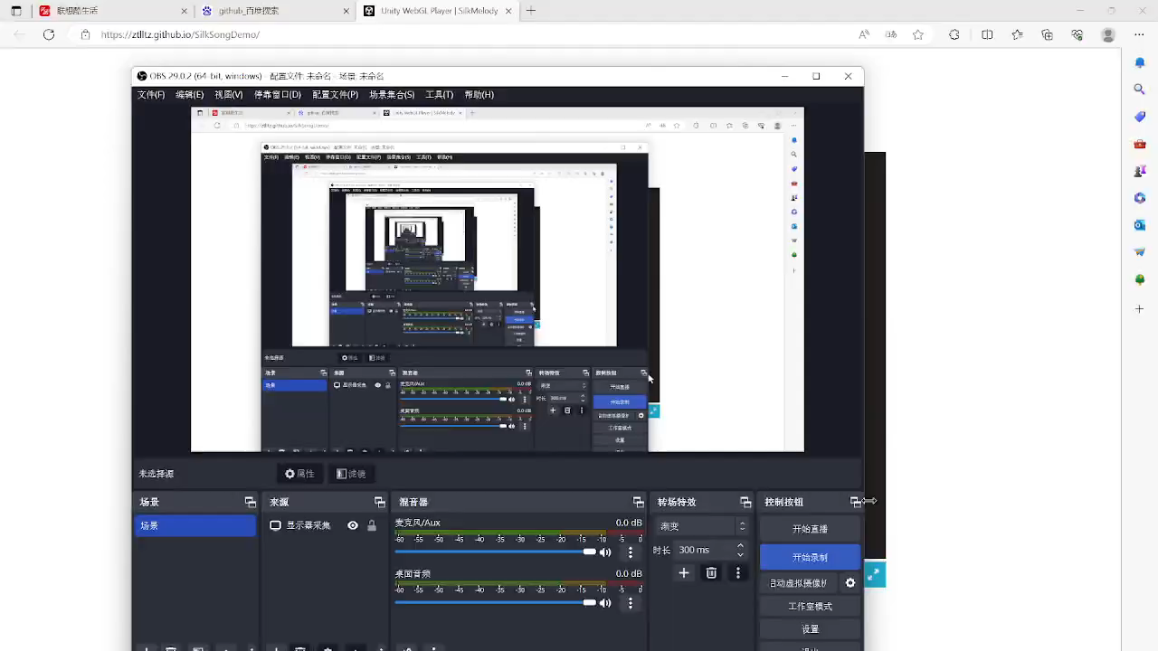

Slide 34
Reference
https://github.com/lamnguyenkhoa/SilkMelody
https://drive.google.com/drive/folders/1SDC_y4s-RfBxAH4oxwYpenpZO97lTGmW?usp=drive_link
https://b23.tv/JxYFgcM
If you want to experience our early version , you can click the link:
https://ztlltz.github.io/SilkSongDemo/

